Slide 1
Induction

Slide 2
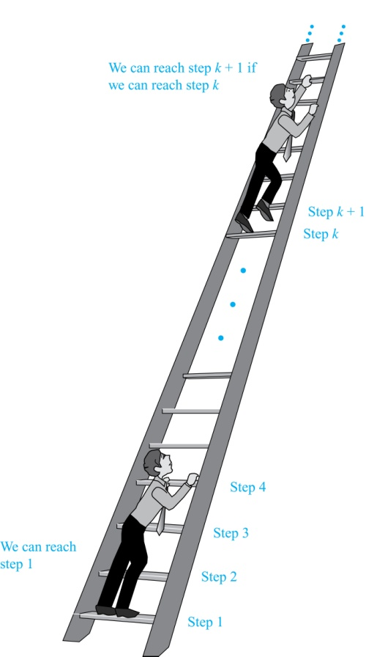
Climbing an Infinite Ladder
Suppose we have an infinite ladder:
We can reach the first rung of the ladder.
If we can reach a particular rung of the ladder, then we can reach the next rung.
From (1), we can reach the first rung. Then by applying (2), we can reach the second rung. Applying (2) again, the third rung. And so on. We can apply (2) any number of times to reach any particular rung, no matter how high up.
This example motivates proof by mathematical induction.

Slide 3
Induction
The principle of mathematical induction is a useful tool for proving that a certain predicate is true for all integers greater than or equal to t for some integer t.

Slide 4
Induction
If we have a propositional function P(n), and we want to prove that P(n) is true for every integer n that is greater than or equal to a given integer t:
Show that P(t) is true. (basis step)
Show that if P(n) then P(n + 1) for any integer n that is greater than or equal to t. (inductive step)
Then P(n) must be true for every integer n that is greater than or equal to t. (conclusion)

Slide 5
Principle of Mathematical Induction
Principle of Mathematical Induction: To prove that P(n) is true for all positive integers n, we complete these steps:
Basis Step: Show that P(1) is true.
Inductive Step: Show that P(k) → P(k + 1) is true for all positive integers k.
To complete the inductive step, assuming the inductive hypothesis that P(k) holds for an arbitrary integer k, show that must P(k + 1) be true.
Climbing an Infinite Ladder Example:
BASIS STEP: By (1), we can reach rung 1.
INDUCTIVE STEP: Assume the inductive hypothesis that we can reach rung k. Then by (2), we can reach rung k + 1.
Hence, P(k) → P(k + 1) is true for all positive integers k. We can reach every rung on the ladder.

Slide 6
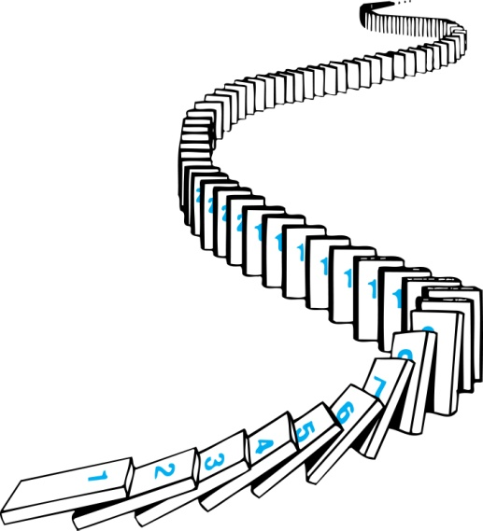
Remembering How Mathematical Induction Works
We know that the first domino is knocked down, i.e., P(1) is true .
We also know that if whenever the kth domino is knocked over, it knocks over the (k + 1)st domino, i.e, P(k) → P(k + 1) is true for all positive integers k.
Consider an infinite sequence of dominoes, labeled 1,2,3, …, where each domino is standing.
Let P(n) be the proposition that the nth domino is knocked over.
Hence, all dominos are knocked over.
P(n) is true for all positive integers n.

Slide 7
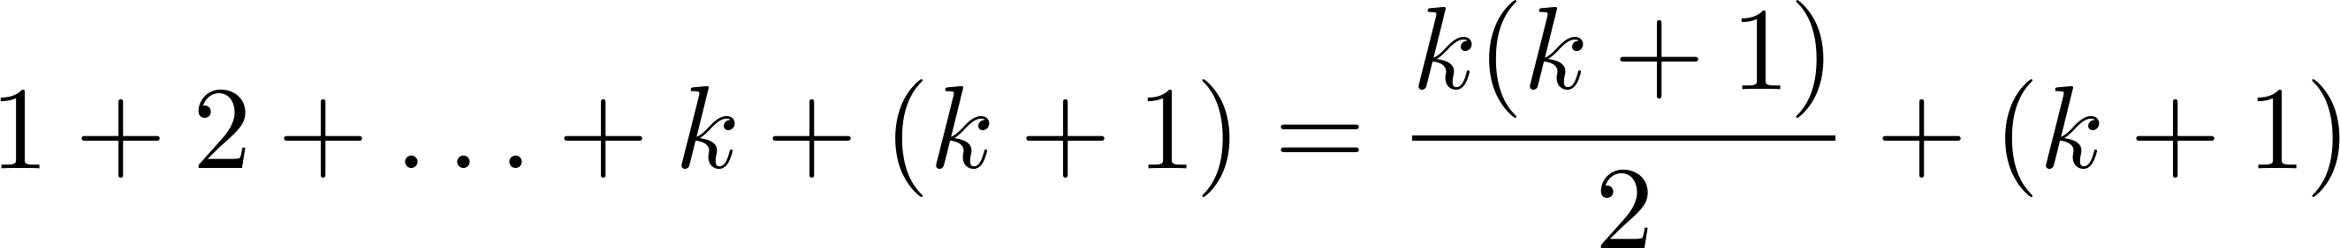
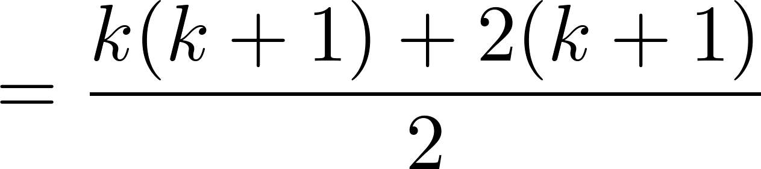
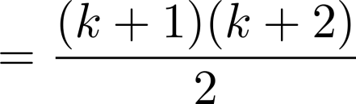

Proving a Summation Formula
Example: Show that:
Solution:
BASIS STEP: P(1) is true since 1(1 + 1)/2 = 1.
INDUCTIVE STEP: Assume the inductive hypothesis holds P(k) and then show that P(k + 1) holds has well.
The inductive hypothesis is
Under this assumption,
$$\sum_{i=1}^{k}{i=\frac{k(k+1)}{2}}$$

Slide 8
〖Example 1〗 , where n is a positive integer
Proof:
Let P(n):
Basis step: P(1) is true because 1=1(1+1)/2
Inductive step: Assume P(k) holds for an arbitrary positive
Integer k. That is,
then
Therefore ∀ k P(k) → P(k+1) is true
By mathematical induction, ∀ n P(n) is true for all positive integer n

Slide 9

Conjecturing and Proving Correct a Summation Formula
Example: Conjecture and prove correct a formula for the sum of the first n positive odd integers. Then prove your conjecture.
Solution: We have: 1= 1, 1 + 3 = 4, 1 + 3 + 5 = 9, 1 + 3 + 5 + 7 = 16, 1 + 3 + 5 + 7 + 9 = 25.
We can conjecture that the sum of the first n positive odd integers is n²,
We prove the conjecture is proved correct with mathematical induction.
BASIS STEP: P(1) is true since 1² = 1.
INDUCTIVE STEP: P(k) → P(k + 1) for every positive integer k.
Assume the inductive hypothesis holds and then show that P(k + 1) holds has well.
So, assuming P(k), it follows that:
Hence, we have shown that P(k + 1) follows from P(k). Therefore the sum of the first n positive odd integers is n².
$$1+3+5+…+(2n−1)=n^{2}$$
Inductive Hypothesis: 1 + 3 + 5 + ∙∙∙+ (2k − 1) =k²
1 + 3 + 5 + ∙∙∙+ (2k − 1) + (2k + 1) =[1 + 3 + 5 + ∙∙∙+ (2k − 1)] + (2k + 1)
= k² + (2k + 1) (by the inductive hypothesis)
= k² + 2k + 1
= (k + 1) ²

Slide 10
Proving Inequalities
Example: Use mathematical induction to prove that n < 2^{n} for all positive integers n.
Solution: Let P(n) be the proposition that n < 2^{n}.
BASIS STEP: P(1) is true since 1 < 2¹ = 2.
INDUCTIVE STEP: Assume P(k) holds, i.e., k < 2^{k}, for an arbitrary positive integer k.
Must show that P(k + 1) holds. Since by the inductive hypothesis, k < 2^{k}, it follows that:
k + 1 < 2^{k} + 1 ≤ 2^{k} + 2^{k} = 2^{k} (1+1 )= 2 ∙ 2^{k} = 2^{k+1}
Therefore n < 2^{n} holds for all positive integers n.

Slide 11
Use mathematical induction to prove that
n < 2^{n} for all positive integers n.
Proof:
Let P(n): n < 2^{n}.
Basis step: P(1) is true because 1 < 2¹ = 2.
Inductive step: Assume P(k) holds for an arbitrary positive
Integer k, i.e., k < 2^{k}.
Since by the inductive hypothesis, k < 2^{k}, it follows that:
k + 1 < 2^{k} + 1 ≤ 2^{k} + 2^{k} = 2 ∙ 2^{k} = 2^{k+1}
Therefore ∀ k P(k) → P(k+1) is true
By mathematical induction, n < 2^{n} holds for all positive integers n.

Slide 12
Proving Inequalities
Example: Use mathematical induction to prove that 2^{n} < n!, for every integer n ≥ 4.
Solution: Let P(n) be the proposition that 2^{n} < n!.
BASIS STEP: P(4) is true since 2⁴ = 16 < 4! = 24.
INDUCTIVE STEP: Assume P(k) holds, i.e., 2^{k} < k! for an arbitrary integer k ≥ 4. To show that P(k + 1) holds:
2^{k+1} = 2∙2^{k}
< 2∙ k! (by the inductive hypothesis)
< (k + 1)k!
= (k + 1)!
Therefore, 2^{n} < n! holds, for every integer n ≥ 4.
Note that here the basis step is P(4), since P(0), P(1), P(2), and P(3) are all false.

Slide 13
The harmonic numbers H_{k}, k =1,2,3,…, are
defined by . Use MI to show that
whenever n is a nonnegative integer.
Pf : Let P(n) be the proposition that “ ”.
Basis step : P(0) is true, since .
Inductive step : Assume that P(k) is true for some k,
i.e.,
Consider P(k+1) :

Slide 14
∴P(k+1) is true.
By MI, P(n) is true for all n∈Z⁺.

Slide 15

Assignment
Use mathematical induction to show that for all non-negative integers n, $1+2^{2}+2^{3}+….+ 2^{n}=2^{n+1}−1$
Prove $2^{n}<n! ∀n∈z^{+}$ and n>=4

Slide 16
Proving Divisibility Results
Example: Use mathematical induction to prove that n³ − n is divisible by 3, for every positive integer n.
Solution: Let P(n) be the proposition that n³ − n is divisible by 3.
BASIS STEP: P(1) is true since 1³ − 1 = 0, which is divisible by 3.
INDUCTIVE STEP: Assume P(k) holds, i.e., k³ − k is divisible by 3, for an arbitrary positive integer k. To show that P(k + 1) follows:
(k + 1)³ − (k + 1) = (k³ + 3k² + 3k + 1) − (k + 1)
= (k³ − k) + 3(k² + k)
By the inductive hypothesis, the first term (k³ − k) is divisible by 3 and the second term is divisible by 3 since it is an integer multiplied by 3. So (k + 1)³ − (k + 1) is divisible by 3.
Therefore, n³ − n is divisible by 3, for every positive integer n.

Slide 17
Show that if n∈Z and n >1, then n can be written as the product of primes.
Pf : Let P(n) be the proposition that n can be written as the product of primes.
Basis : P(2) is true, since 2 is a prime number
Inductive : Assume P(2), P(3), …, P(k) are true.
Consider P(k + 1) :
Case 1 : k + 1 is prime ⇒ P(k+1) is true
Case 2 : k + 1 is composite, i.e., k + 1 = ab where 2 ≤ a ≤ b ＜ k+1
By the induction hypothesis, both a and b can be written as the product of primes.
⇒ P(k+1) is true.
By Strong MI, P(k) is true if k∈Z and k >1.

Slide 18
Prove that every amount of postage of 12 cents or more can be formed using just 4-cent and 5-cent stamps.
Pf : Let P(n) be the statement that the postage of n cents can formed using just 4-cent and 5-cent stamps.
Basis : P(12) is true, since 12 = 4 × 3;
P(13) is true, since 13 = 4 × 2 + 5 × 1;
P(14) is true, since 14 = 4 × 1 + 5 × 2;
P(15) is true, since 15 = 5 × 3;
Inductive : Assume P(12), P(13), …, P(k) are true.
Consider P(k+1) :
Suppose k−3 = 4 × m + 5 × n.
Then k+1 = 4 × (m+1) + 5 × n.
⇒ P(k+1) is true.
By Strong MI, P(n) is true if n∈Z and n ≥12.
(k−3 ≥ 12)

Slide 19
Number of Subsets of a Finite Set
Example: Use mathematical induction to show that if S is a finite set with n elements, where n is a nonnegative integer, then S has 2^{n} subsets.
(Chapter 6 uses combinatorial methods to prove this result.)
Solution: Let P(n) be the proposition that a set with n elements has 2^{n} subsets.
Basis Step: P(0) is true, because the empty set has only itself as a subset and 2⁰ = 1.
Inductive Step: Assume P(k) is true for an arbitrary nonnegative integer k.
continued →

Slide 20
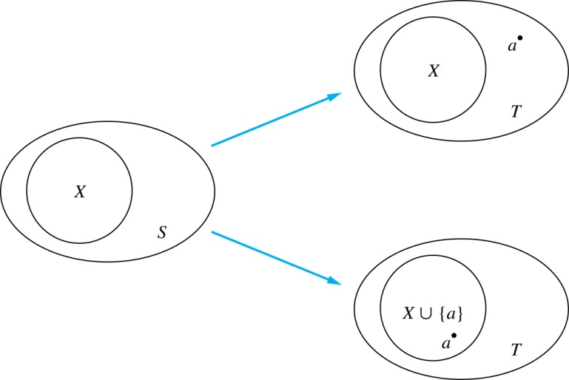
Number of Subsets of a Finite Set
Let T be a set with k + 1 elements. Then T = S ∪ {a}, where a ∈ T and S = T − {a}. Hence |S| = k.
For each subset X of S, there are exactly two subsets of T, i.e., X and X ∪ {a}.
By the inductive hypothesis S has 2^{k} subsets. Since there are two subsets of T for each subset of S, the number of subsets of T is 2 ∙2^{k} = 2^{k+1} .
Inductive Hypothesis: For an arbitrary nonnegative integer k, every set with k elements has 2^{k} subsets.

